Slide 1
Intersection of Data, Policy and Privacy
Prof. Ravi Sandhu
Executive Director and Endowed Chair
Texas Fresh Air
Big Data and Data Analytics Conference
Roundtable
March 31, 2016
ravi.sandhu@utsa.edu
www.profsandhu.com
www.ics.utsa.edu
© Ravi Sandhu
World-Leading Research with Real-World Impact!

Slide 2
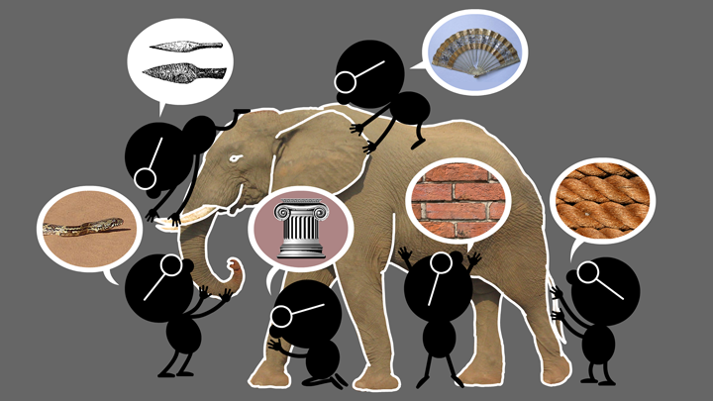
Elephant Problem
© Ravi Sandhu
World-Leading Research with Real-World Impact!
2

Slide 3
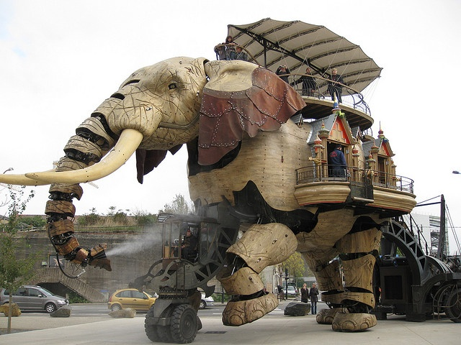
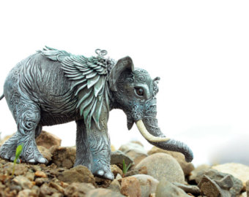
Cyber-Elephant Problem
© Ravi Sandhu
World-Leading Research with Real-World Impact!
3

Slide 4
Trade-Offs
Benefit
Privacy
Security
© Ravi Sandhu
World-Leading Research with Real-World Impact!
4

Slide 5
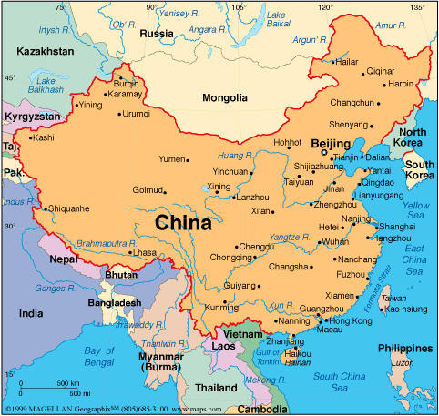
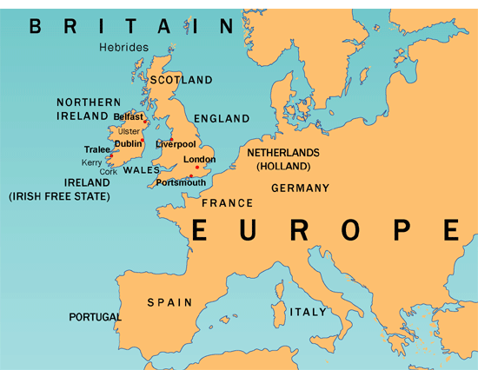
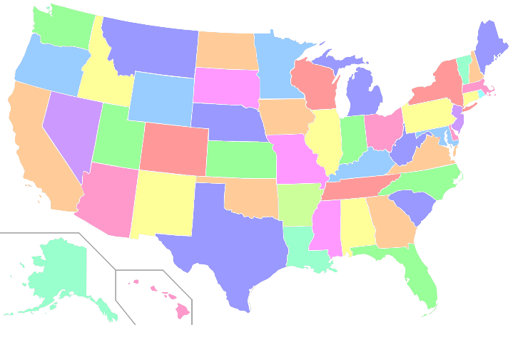
3 Ongoing Experiments
© Ravi Sandhu
World-Leading Research with Real-World Impact!
5

